Slide 1


COVID-19 in Italy
Prof. Silvio Brusaferro
President
Istituto Superiore di Sanità
Img Source: https://pixabay.com/vectors/virus-corona-covid-19-coronavirus-5182547/

Slide 2
An unprecedented event, a «wicked» problem
“The COVID-19 pandemic—caused by SARS CoV-2—is a typical wicked problem —we did not see it coming, we experience its effects, and it challenges our entrained ways of thinking and acting.
J.P. Strumberg, C.M. Martin. J. Eval. Clin. Pract. 2020

Slide 3
Overview

Slide 4

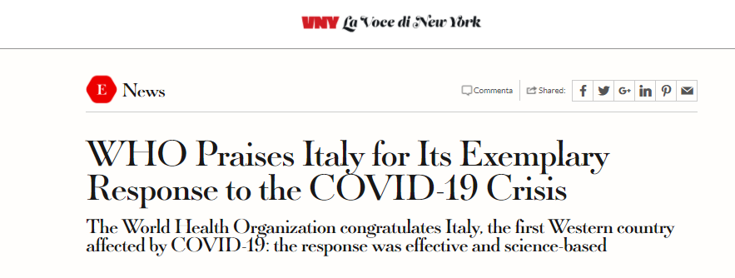
Country response to the first acute phase
Need to be «Icebreakers»
Institutional synergy
Strong, fast coherent response
Set up of a specific data collection systems from the Regions
Population and context resilience
  Acceptability
Training and information

Slide 5
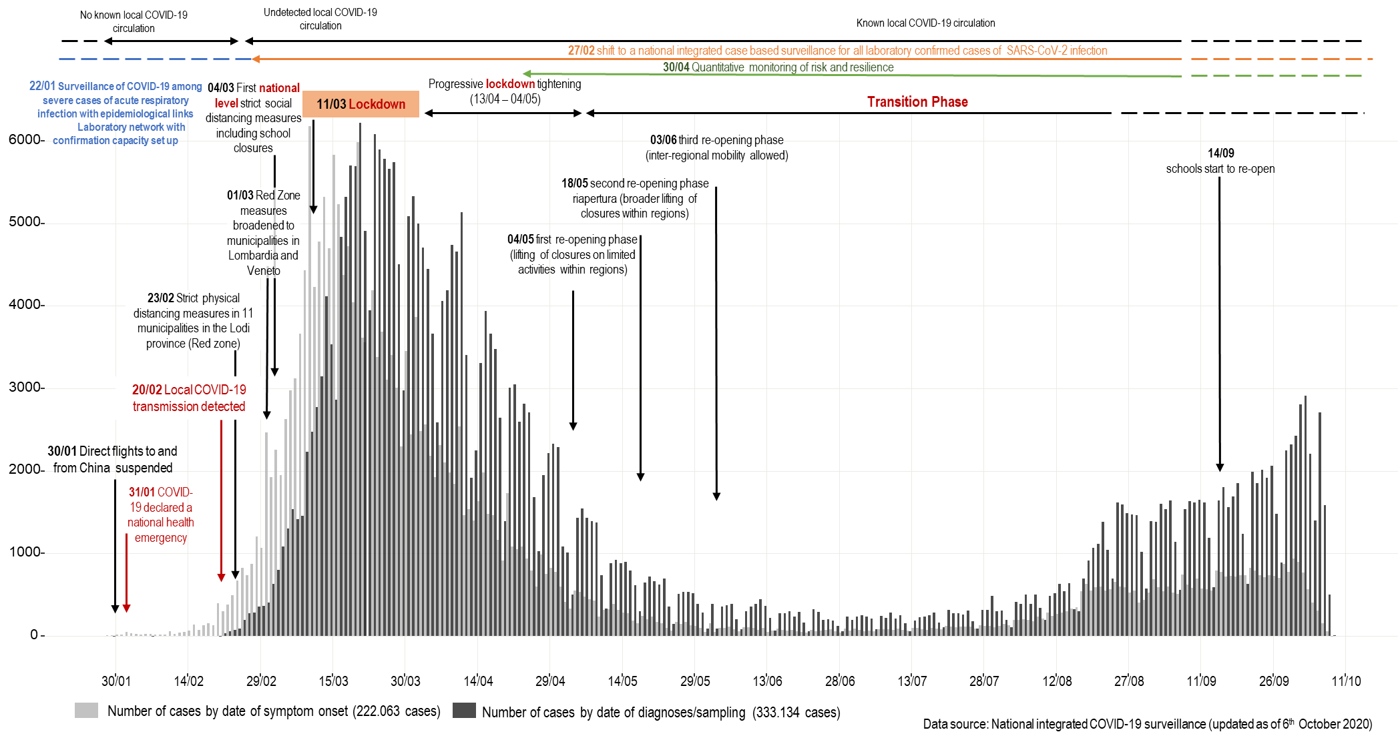

Slide 6
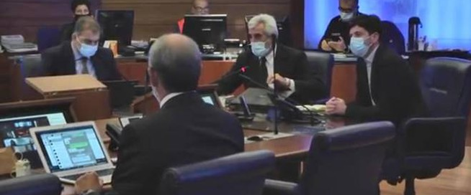
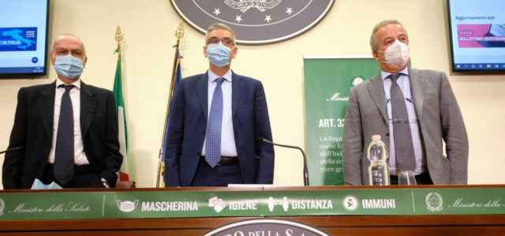
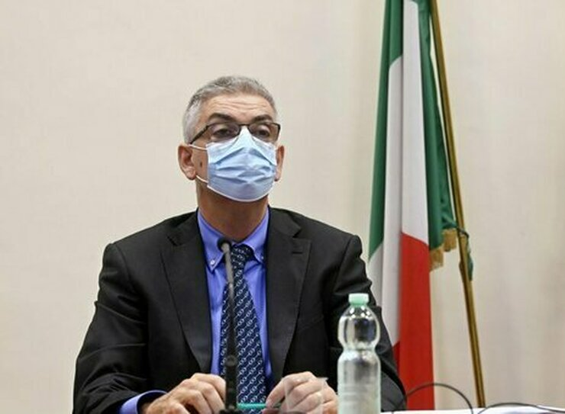
COVID-19 National scientific advisory board
The New Italian Technical Scientific Commitee on Covid-19 from March 17,2021
(Ordinanza n. 751). (21A01718)(G.U. Serie Generale , n. 66 del 17 marzo 2021)
President of the National Institute of Health

Slide 7
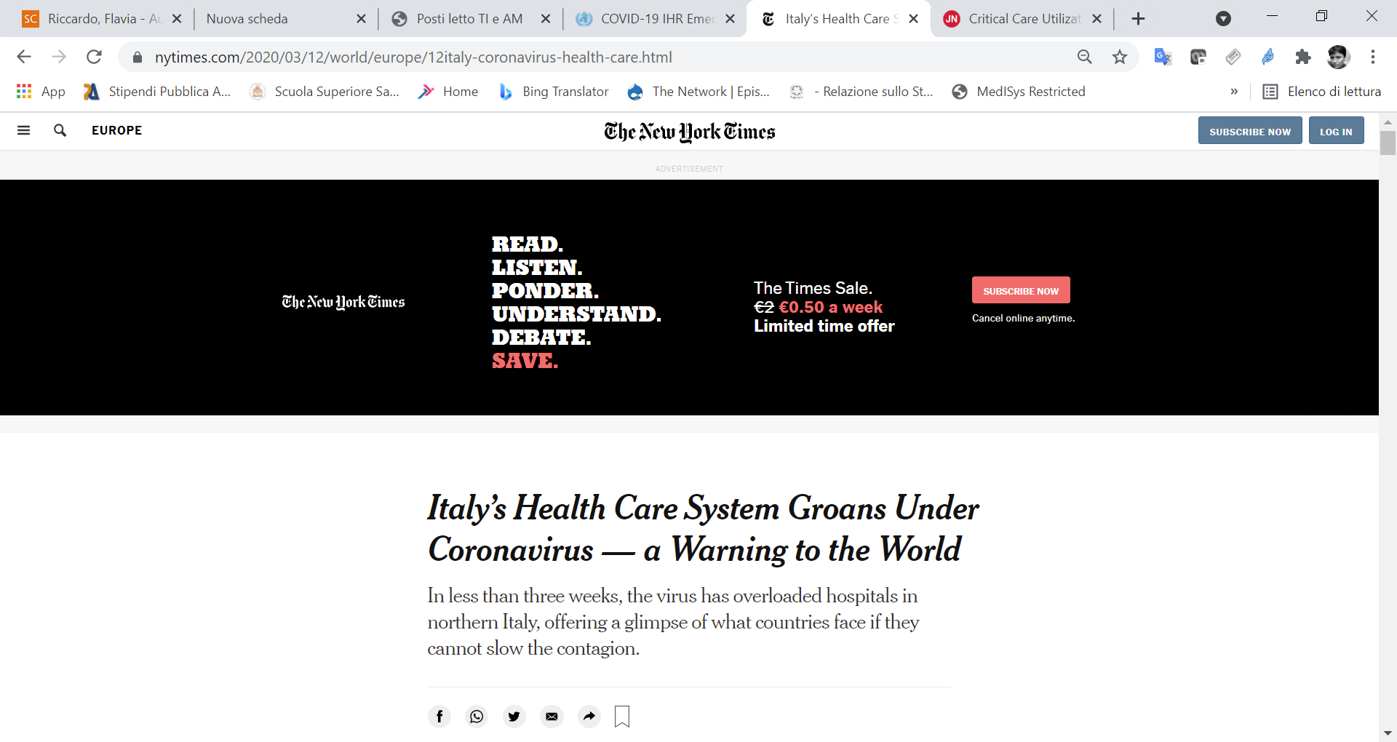
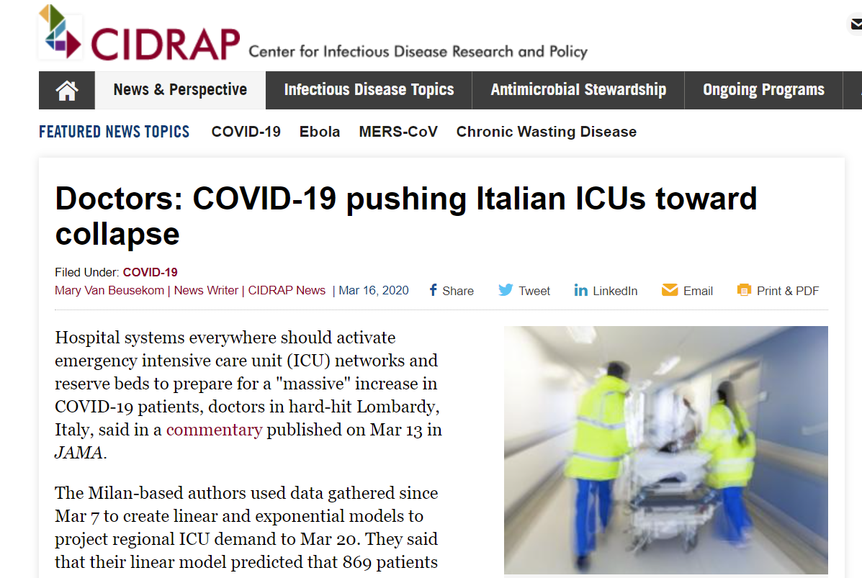
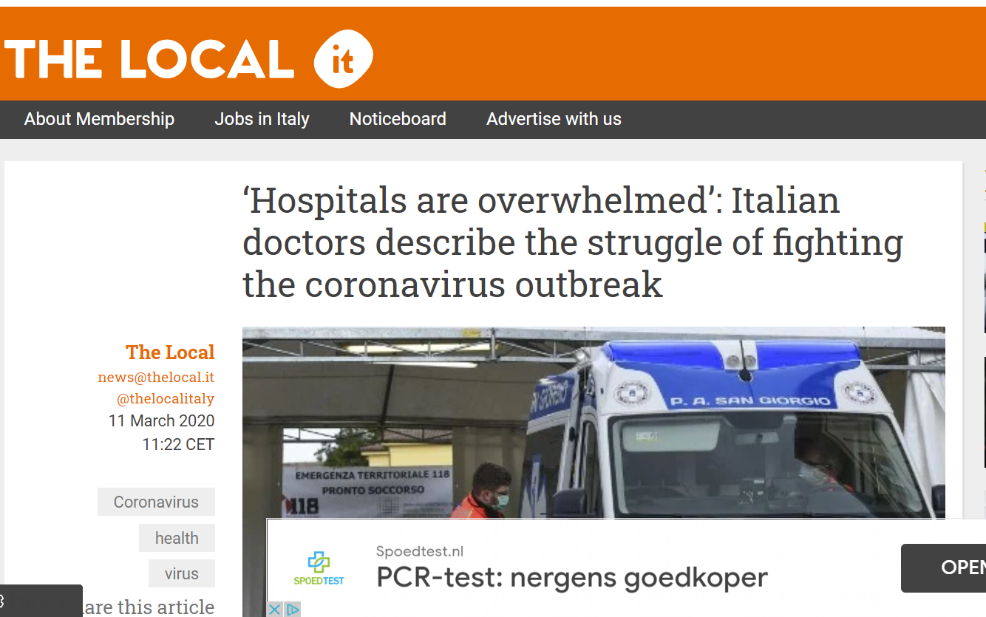
Unprecedented impact on the health system

Slide 8
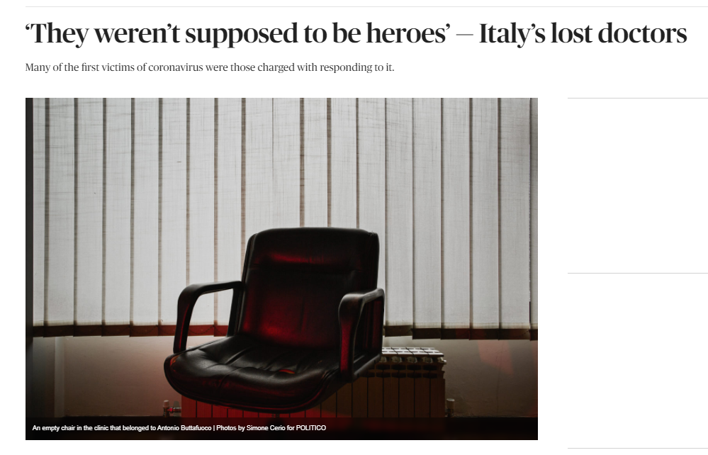
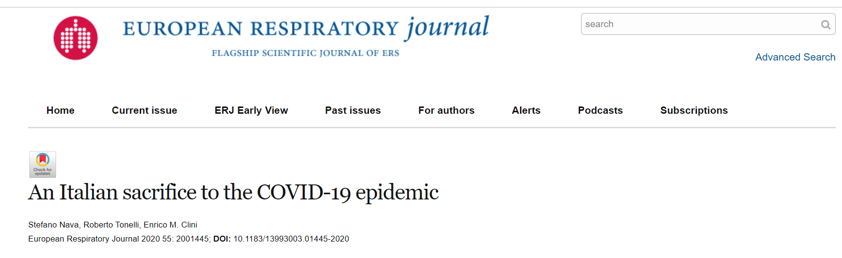
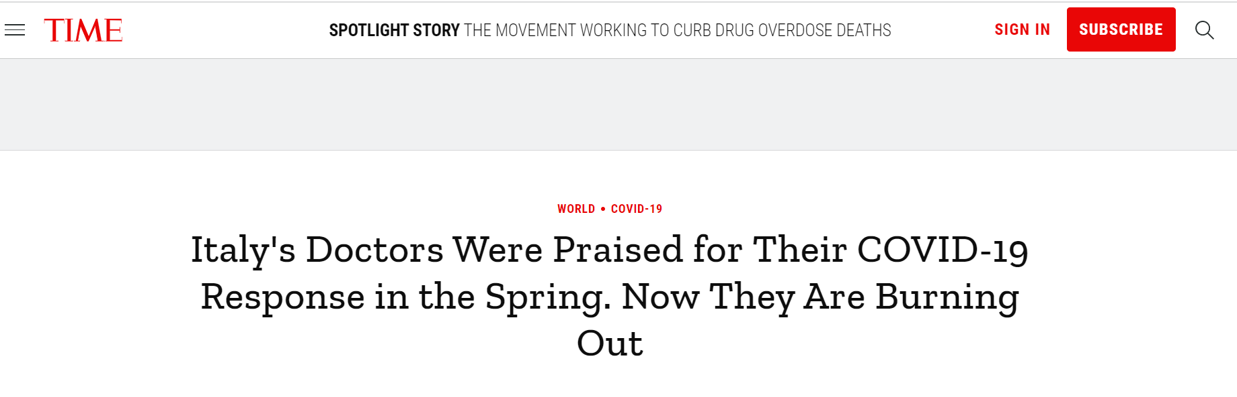
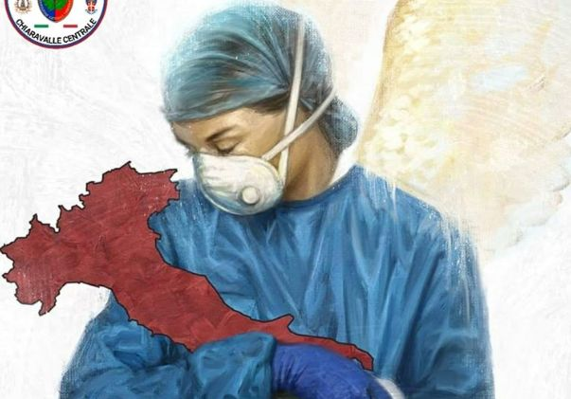
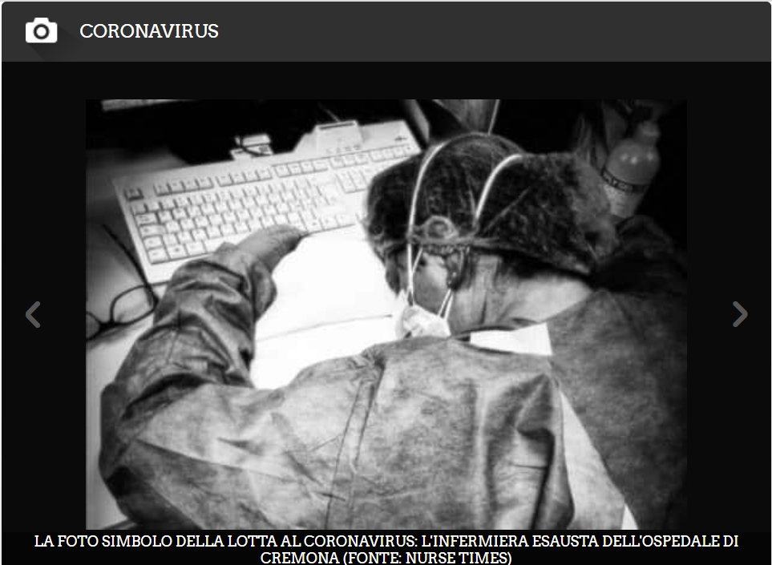
Disproportionate impact on HCW
Image sources: RAI news; Huffington Post; Politico

Slide 9
Italian Institutions and COVID-19 response
AIFA
National Council of Health
Technical Scientific Committee
Civil Protection
ISS
INAIL
Ministry of Health & «Control Room»
State-Regions Conference
ISTAT
AGENAS
Covid-19
Other Institutions

Slide 10


ISS
Activities to face COVID-19 pandemia
Monitoring of epidemic risk
Epidemiological and microbiological surveillance
Support to vaccination control and distribution
Research and development
in One Health perspective
Infection prevention and control
ISS
ESSENTIAL PUBLIC SERVICE
Member of the
Scientific and Technical Committee
(Decree of the Civil Protection Department,
no. 371 February 5, 2020)
and of the Control Room
(Ministerial Decree April 30, 2020)
National and international collaborations
Scientific communication
Scientific publications and technical reports
Distance
learning
Face masks authorization
in derogation
Autorizzazioni
in deroga
delle mascherine
facciali

Slide 11
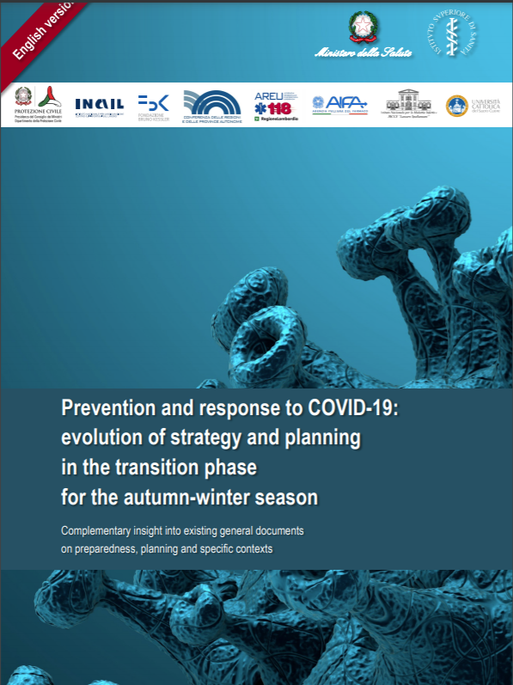
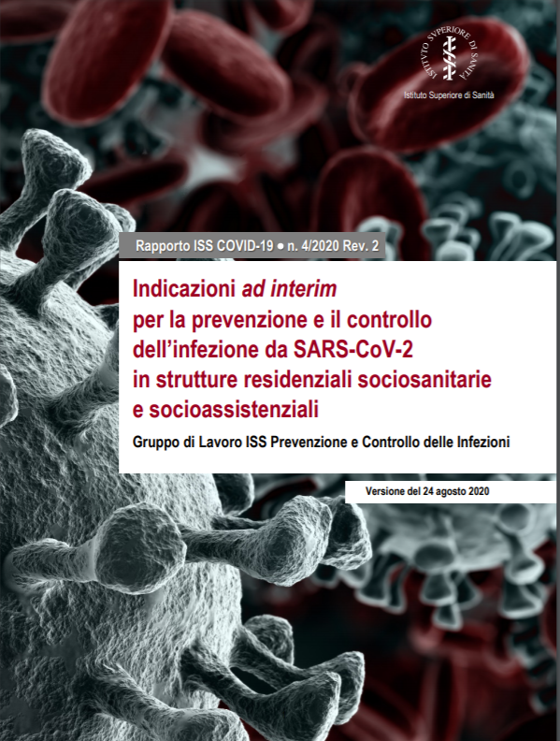
A defined and consensus-driven Strategy Dedicated guidance
Some examples: all reports are available online

Slide 12
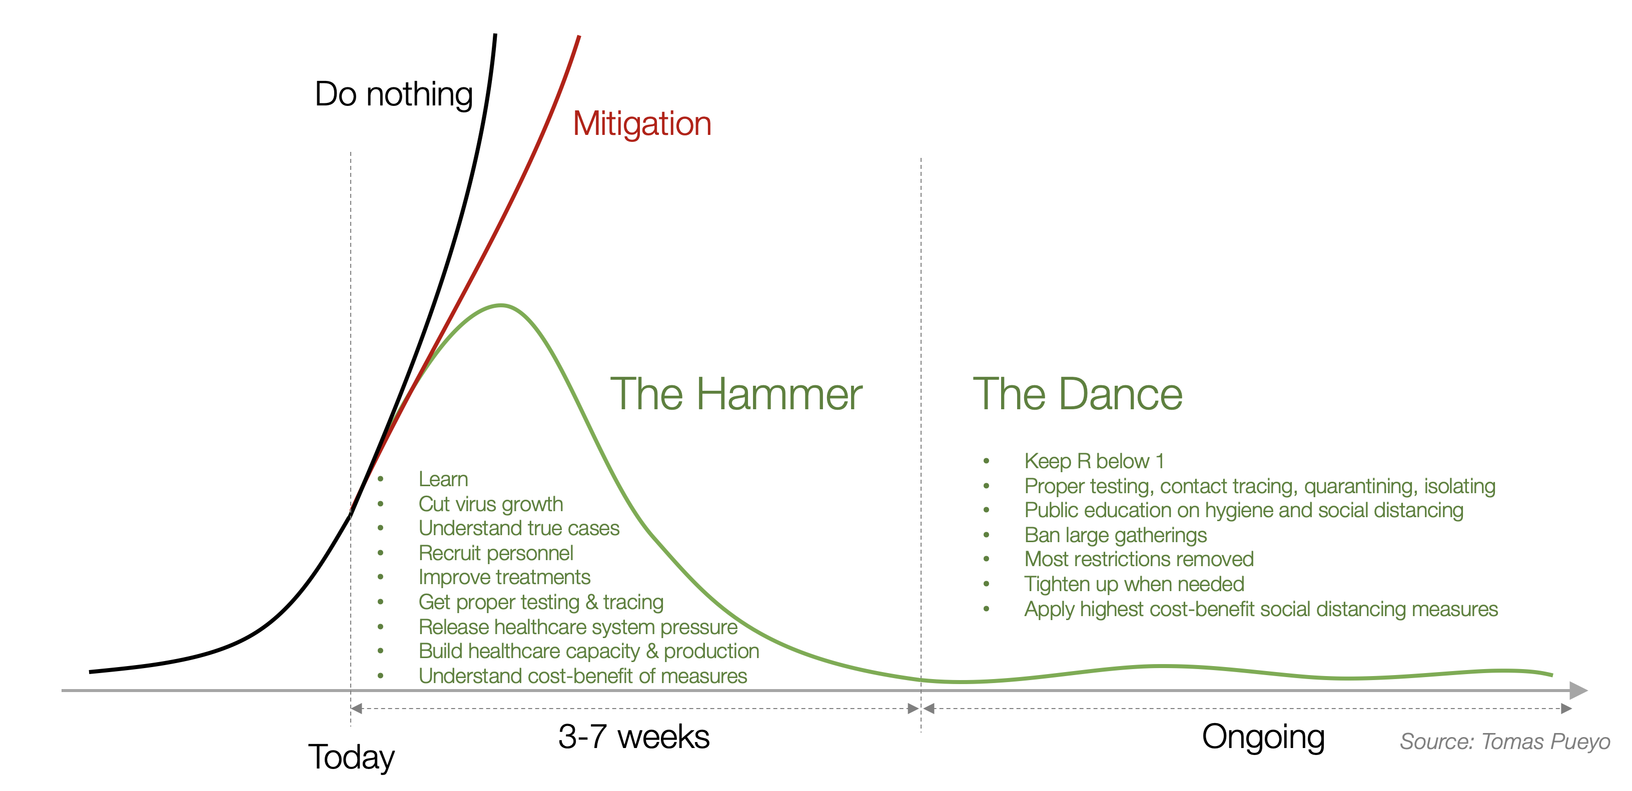
Response strategy: the Hammer and the Dance
https://medium.com/@tomaspueyo/coronavirus-the-hammer-and-the-dance-be9337092b56

Slide 13
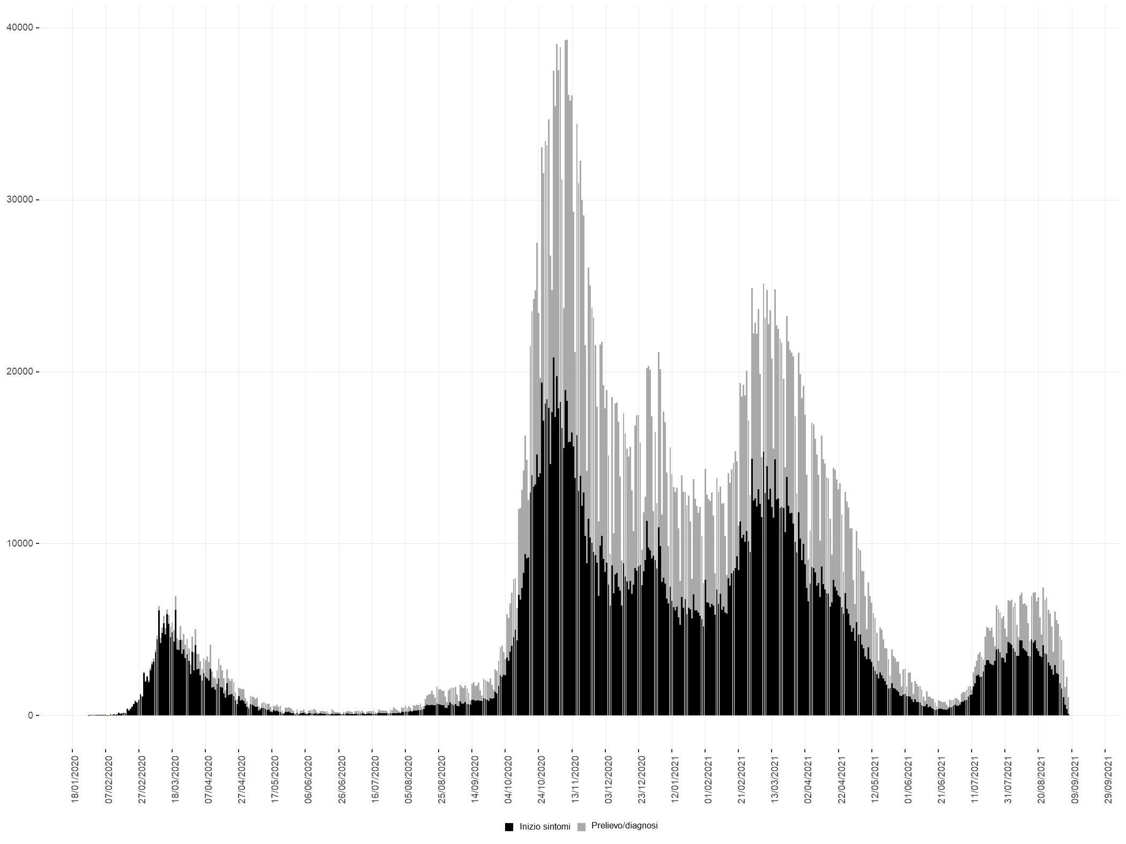
Response strategy
Acute Phase
Transition Phase
Acute Phase
Transition Phase
11/03
Lockdown
04/05-03/06 Gradual reopening
DPCM 3/11 («zone» system)
Parameter modulation: DL 65 May 2021
Parameter modulation: DL 105 July 2021
Parameter modulation: Christmas restrictions
DM 30/04
(Risk assessment)
12/10
(Autumn-winter Strategy adopted)
27/12
Vaccination Campaign begins
Parameter modulation: DL 5 Jan 2021
Mid February 2021
Alfa variant prevalent
End June 2021
Delta variant prevalent
Fonte dati: Sorveglianza nazionale integrata per COVID-19 (aggiornati l’8 settembre 2021)

Slide 14
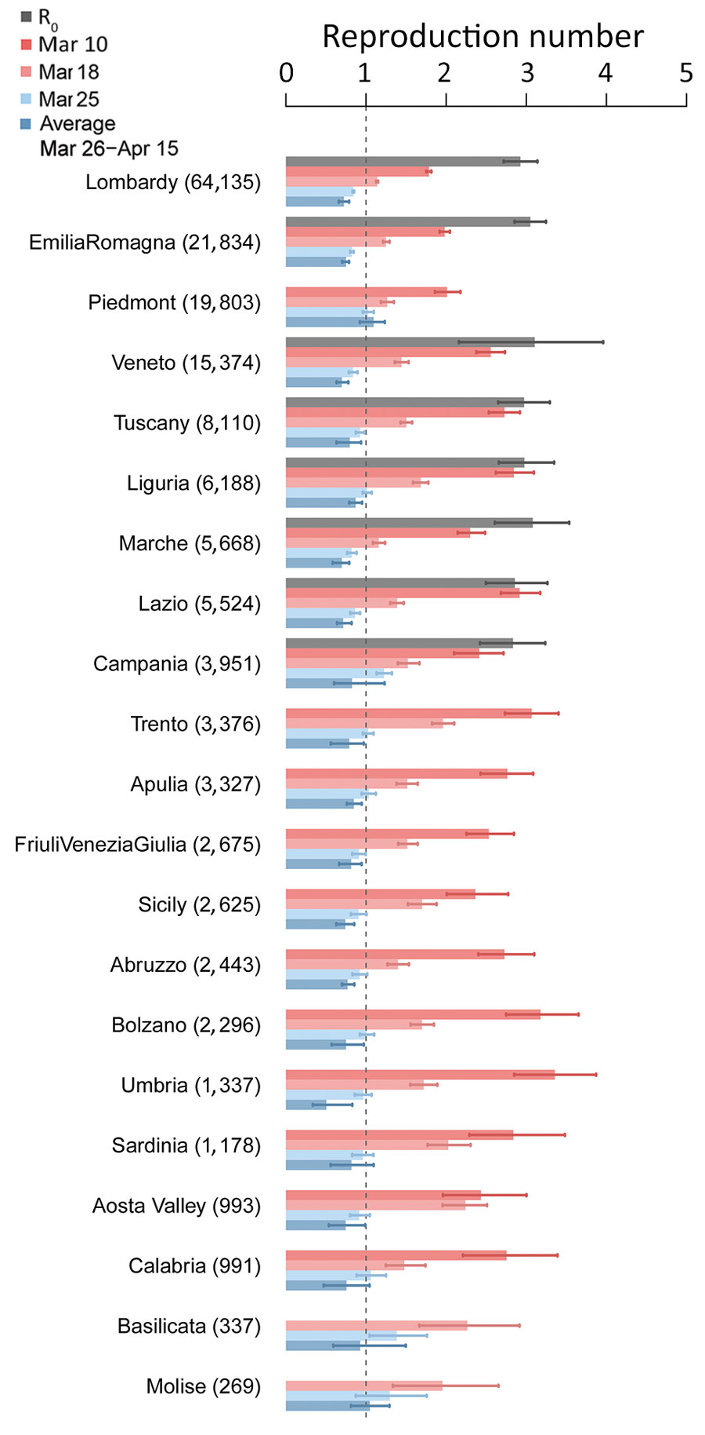
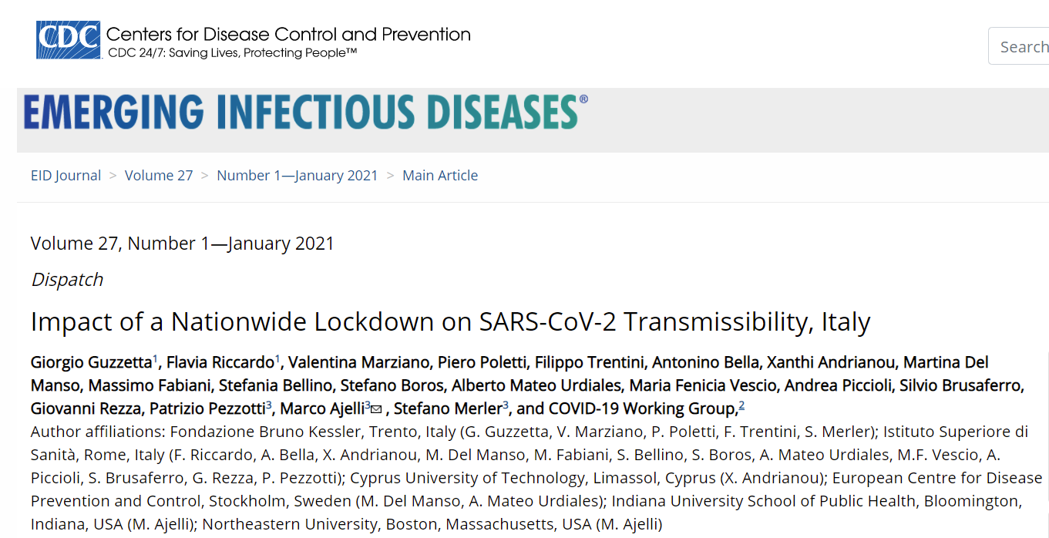
Impact of early (March-May 2020) containment efforts (lockdown)
The national lockdown put in place as of March 11 to limit the spread of SARSCoV-2 in Italy brought Rt below 1 in most regions and provinces within 2 weeks.
“Lockdown was fundamental to prevent an explosion in the number of cases in other regions in which transmission had started weeks later compared with the outbreak epicenter (Lombardy, Veneto, Emilia Romagna).

Slide 15
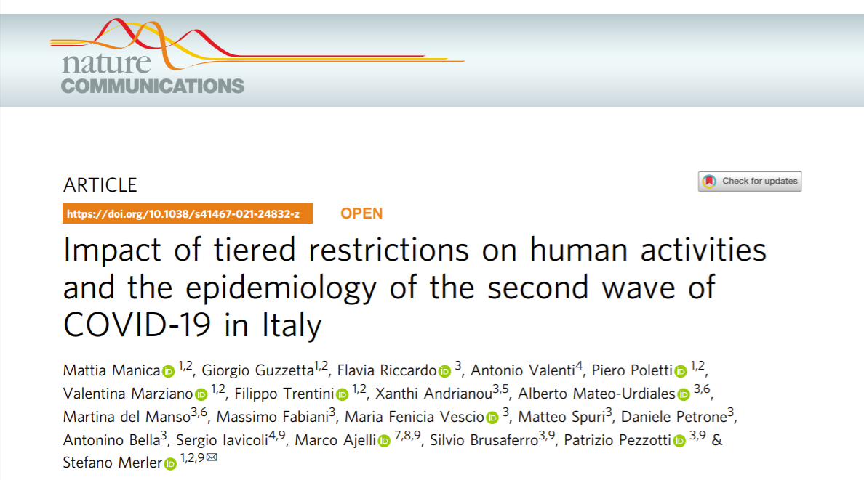
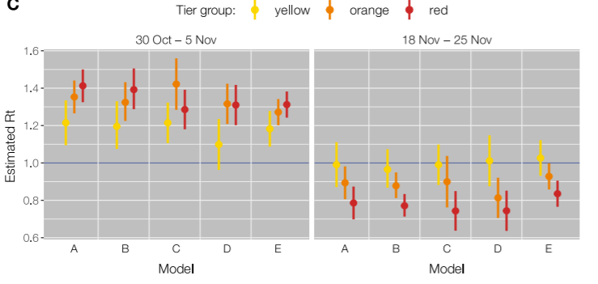
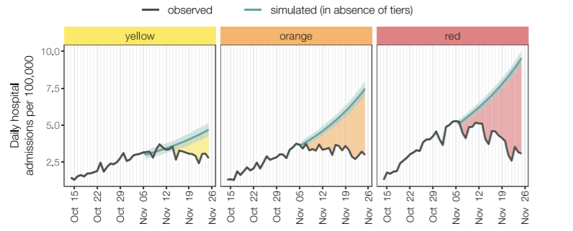
Impact of the flexible regional based “color zone” mitigation approach (from November 2020)
Rt
7 day incidence (since January 2021)
Risk assessment
«colour code» of measures (yellow, orange red) from 5 November 2020 – 17 May 2021
«…the activity reduction in all locations outside of the home was far from that observed during the nationwide lockdown imposed to counter the first wave, even in the strictest tier where a stay-home mandate was in place.

Slide 16
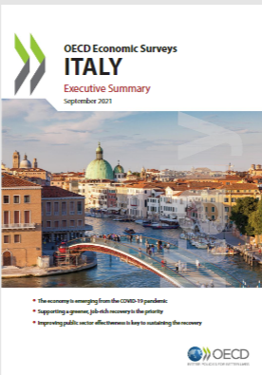
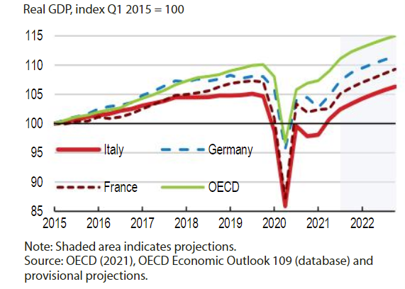
Reduced negative impact on GDP (OECD, 2021)
https://www.oecd.org/economy/italy-economic-snapshot/

Slide 17
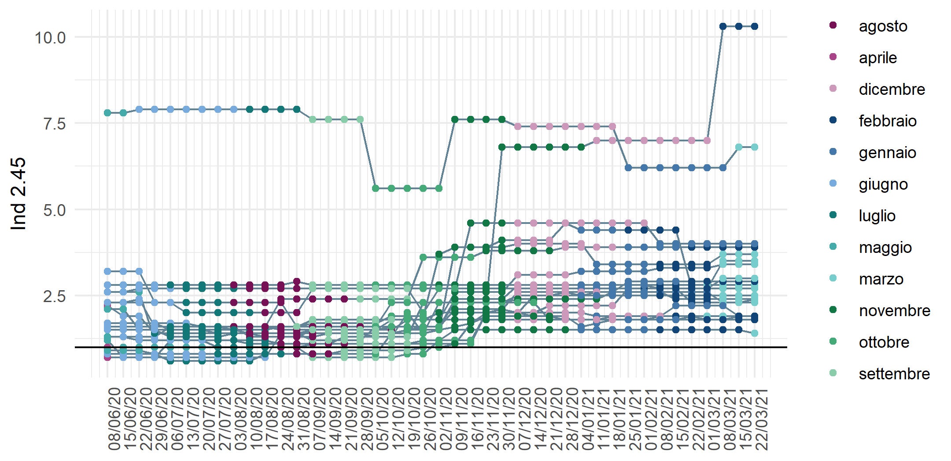
Response pillars – Health system strengthening
Increase in human resources
Human Resources dedicated to contact tracing, diagnoses, monitoring of quarantine and isolation procedures
Target 1 staff/10.000 inh.

Slide 18
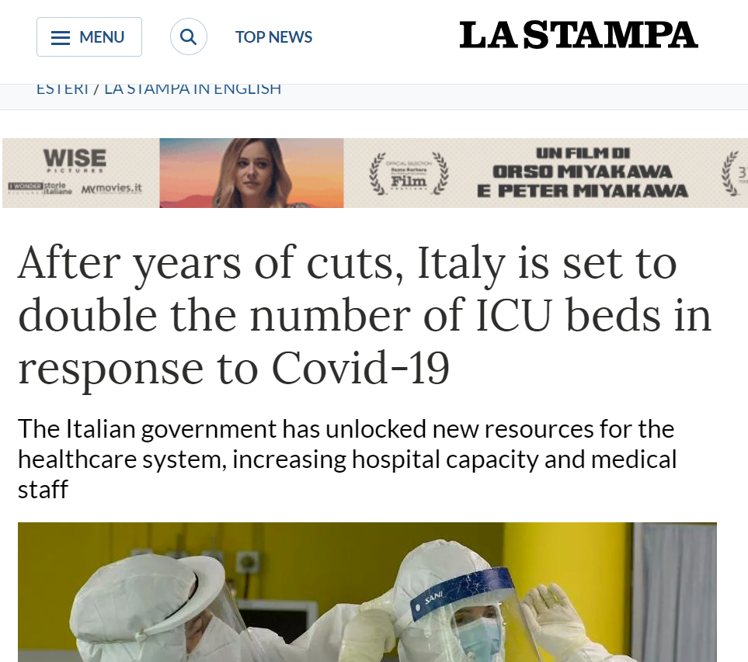
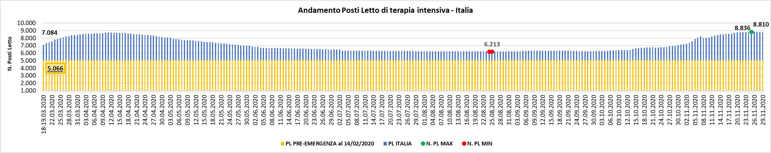
Response pillars – Health system strengthening
Flexible increase in hospital capacity
Emergency upscale of hospital beds (below the example of ICU bed capacity)
Data Source: Italian Ministry of Health

Slide 19
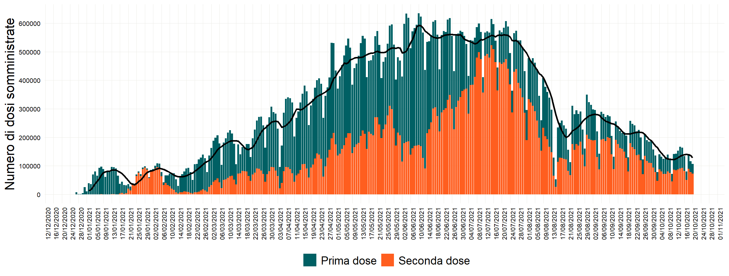
SARS CoV-2 Vaccination campaign 27/12/2020 - 20/10/2021
Data di ultimo aggiornamento: 20 ottobre 2021

Slide 20
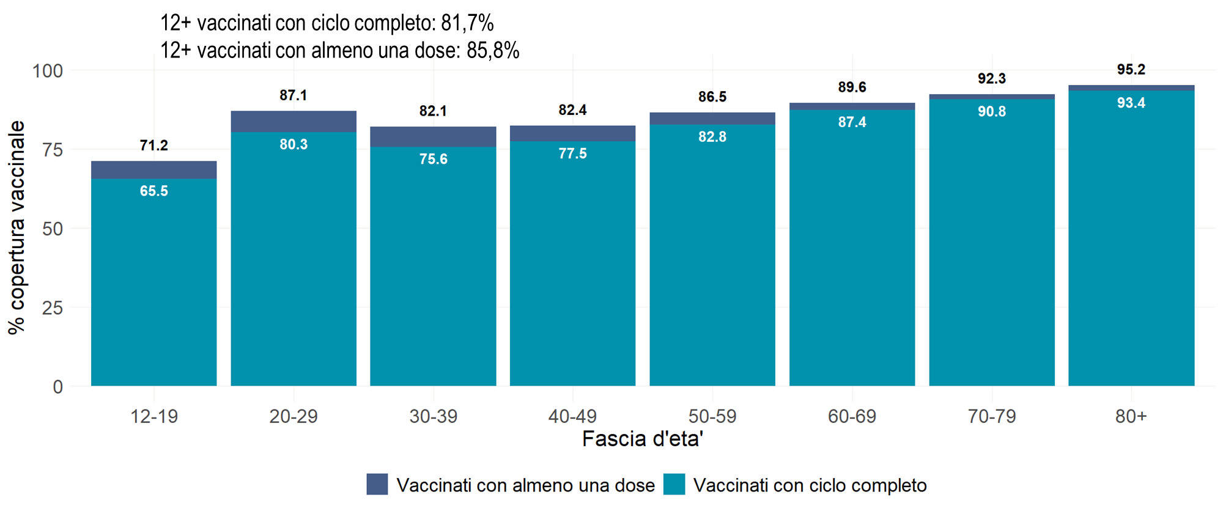
Response pillars – reducing population susceptibility to severe disease (from 27th December 2020)
High SARS-CoV-2 Vaccination Coverage
12+ fully immunized: 81.7%
12+ immunized with at least 1 dose: 85.8%
% of vaccination coverage
Age group
Immunized with at least 1 dose
Fully Immunized

Slide 21
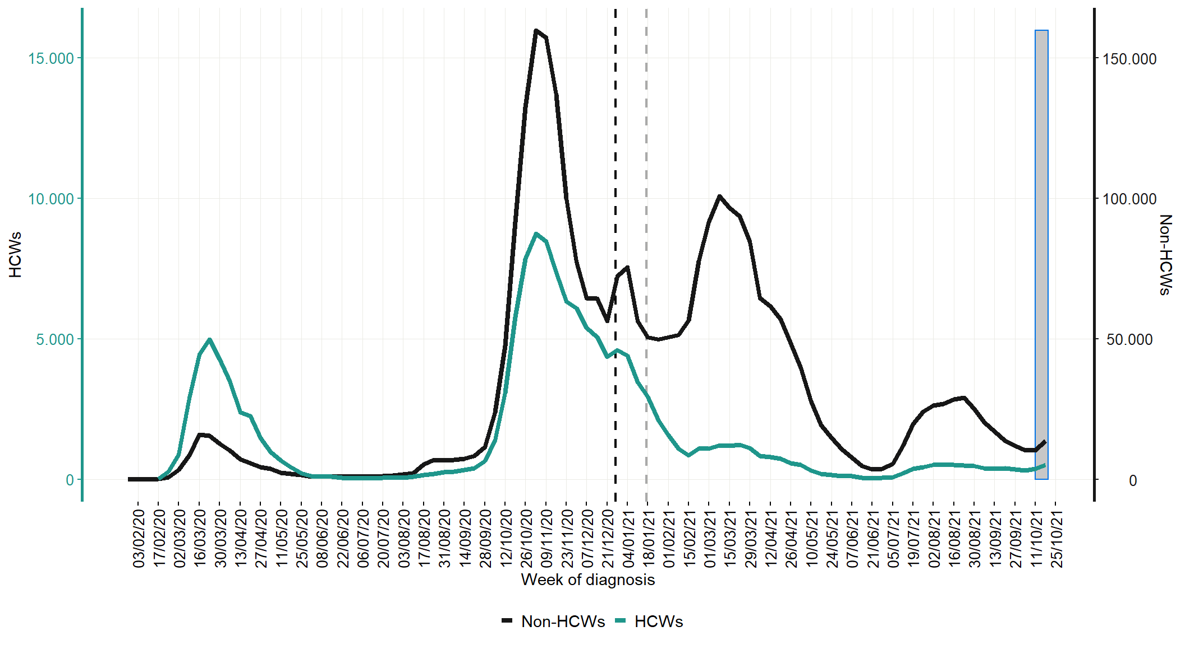
Impact of measures in reducing disproportionate infection risk among HCW
Number of SARS-CoV-2 confirmed infections among Health Care Workers vs the general population,
Italy, 1 February 2020 - 26 October 2021
Vaccination campaign starts
Second dose administration starts

Slide 22
LTCFs and vaccination impact

Slide 23
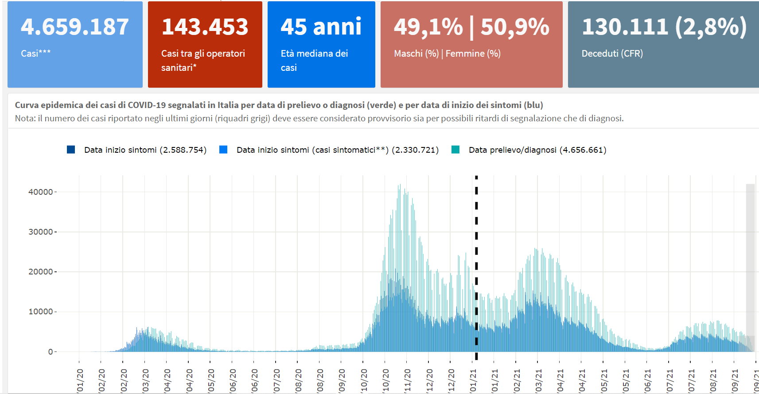
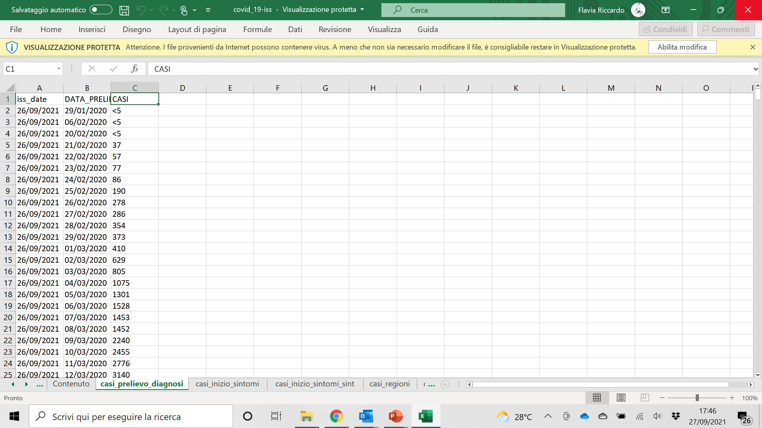
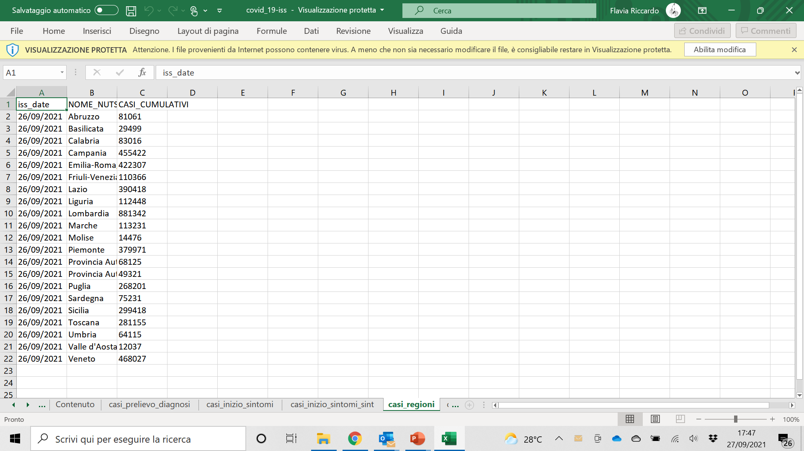
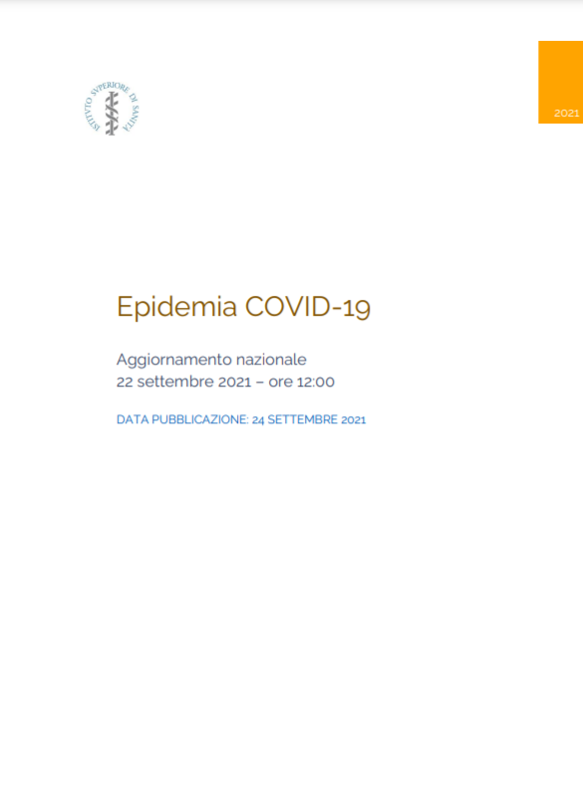
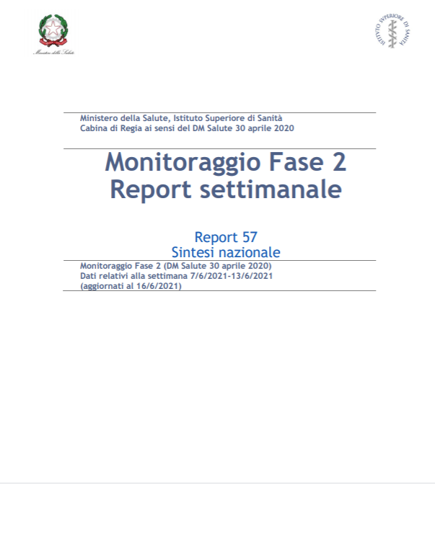
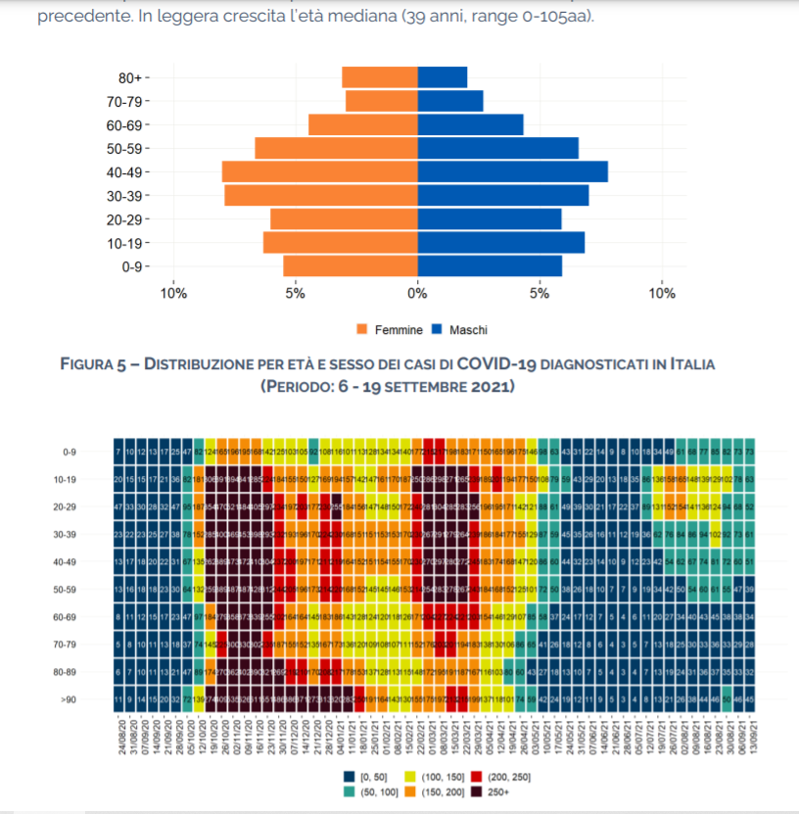
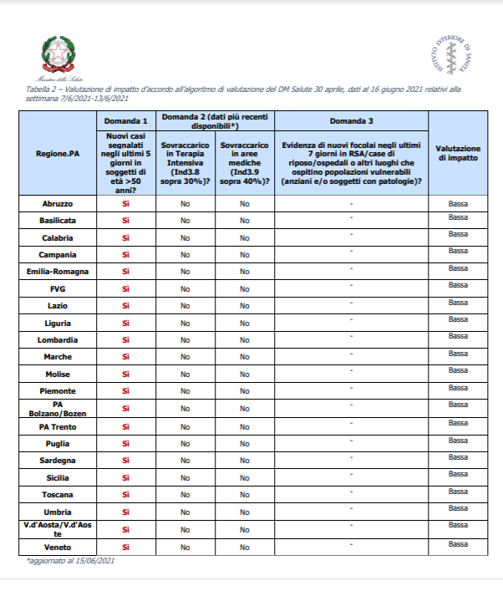
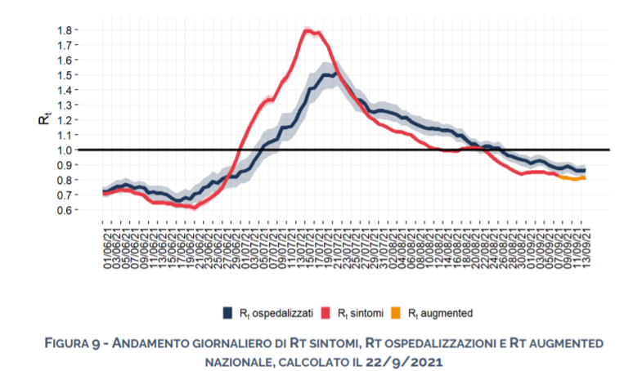
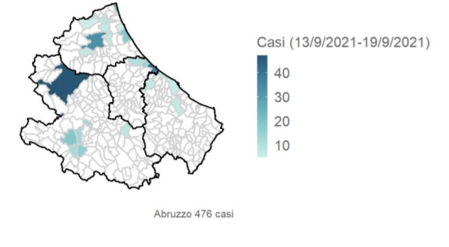
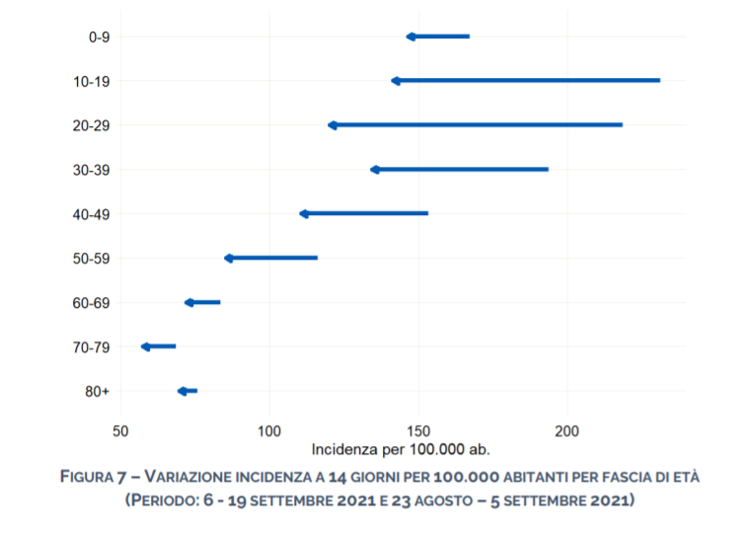
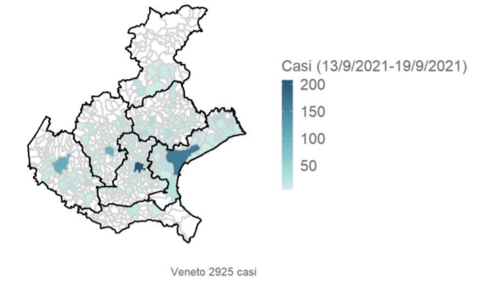
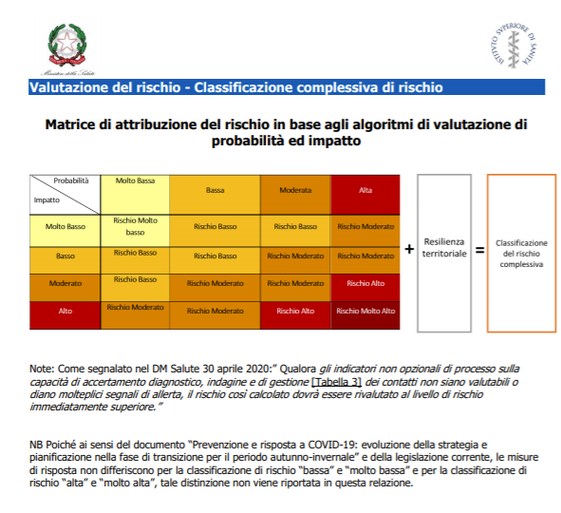
Data and information hub
(including open data)
Response pillars – data for action

Slide 24

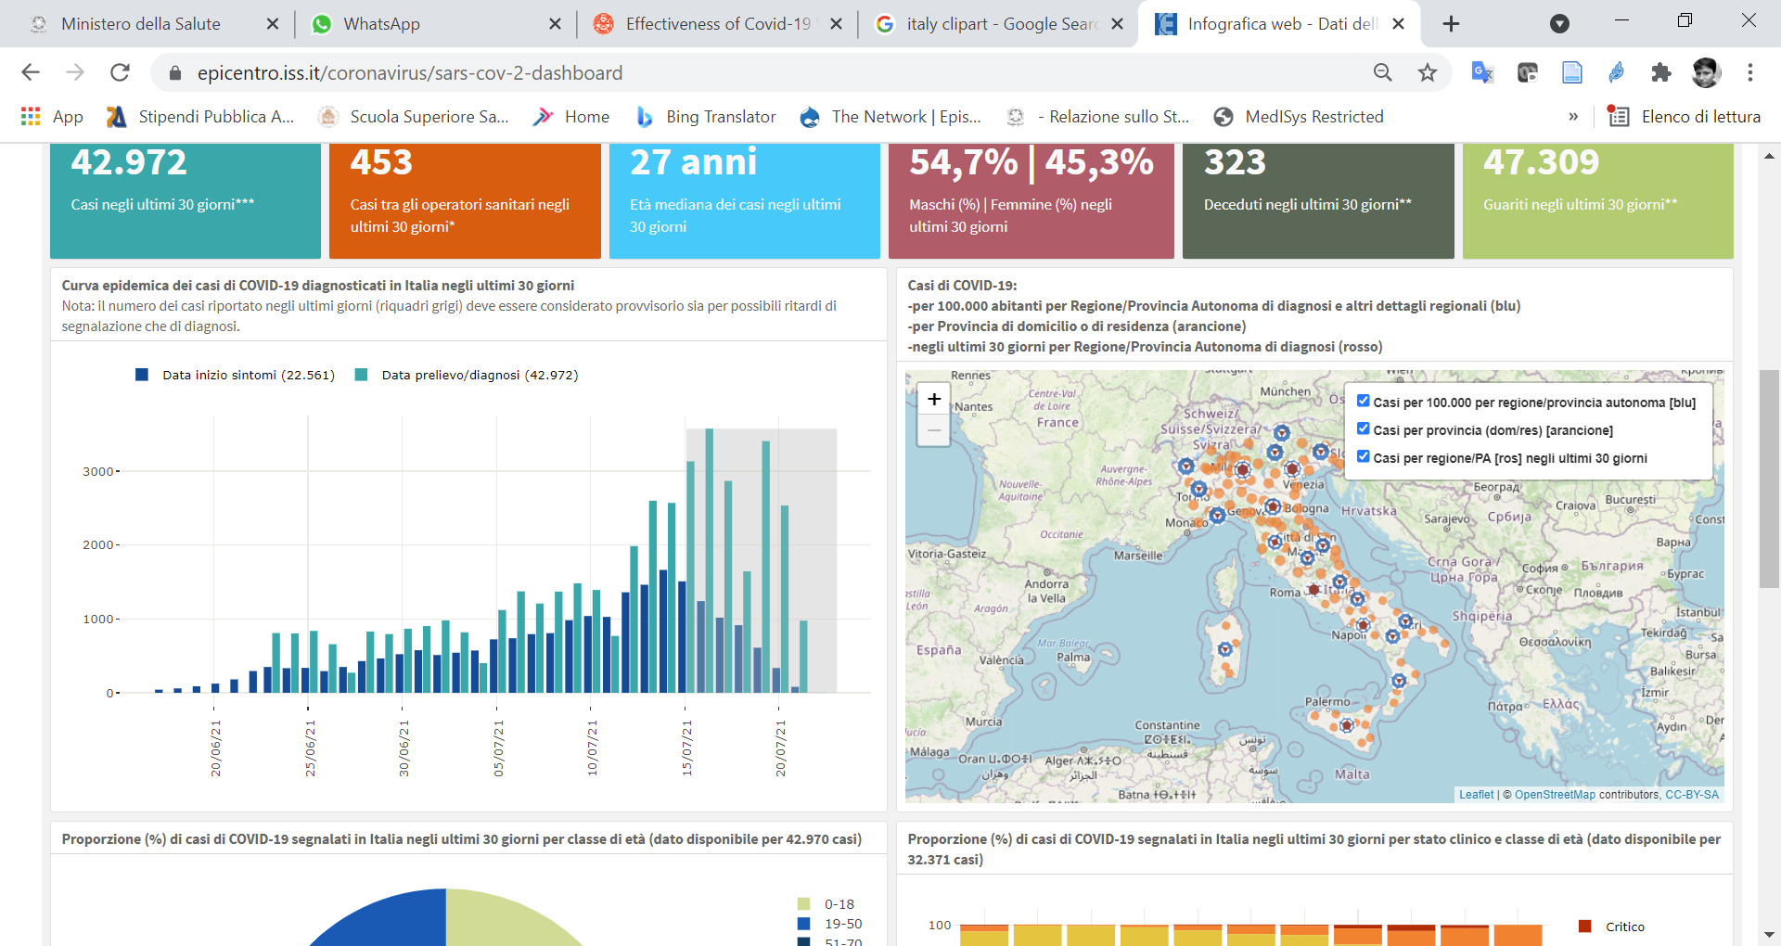


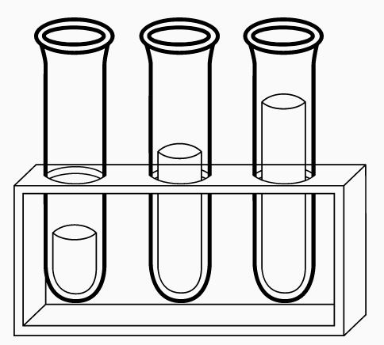




Integrated surveillance
Response pillars – data for action
Wastewater surveillance
Epidemiological and microbiological data
on all laboratory confirmed SARS.CoV-2 cases of infection
COVID-19 laboratory network
VoC/VoI
All SARS-CoV-2 sequences
Integrated surveillance (case-based data)
Genomic surveillance and analysis platform (I-Co-Gen)
National vaccination repository
Image source: CDC

Slide 25
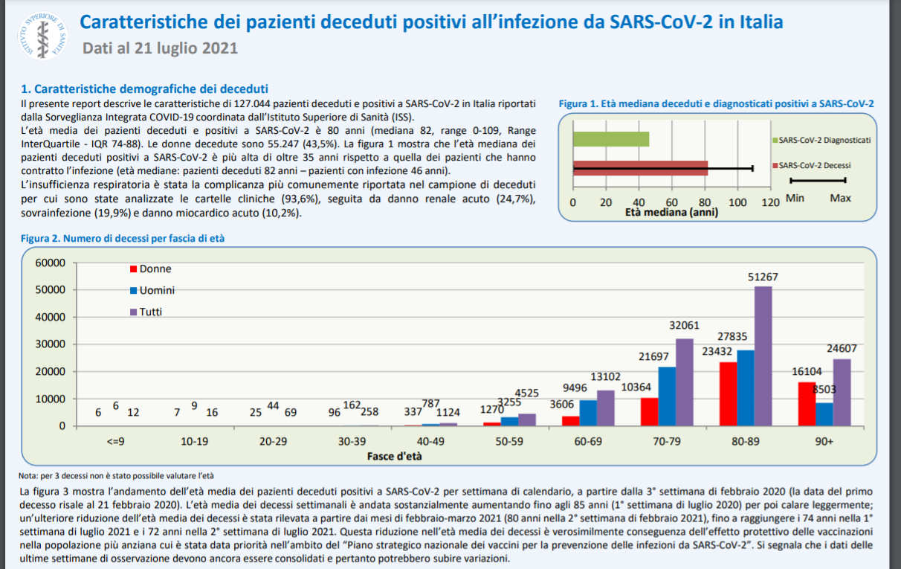
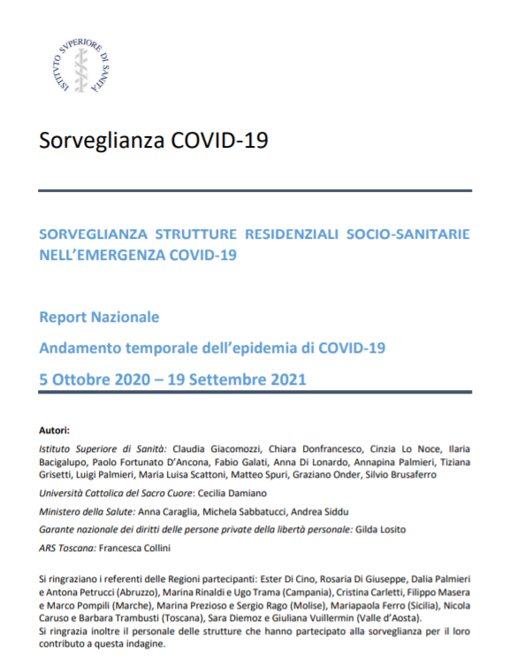
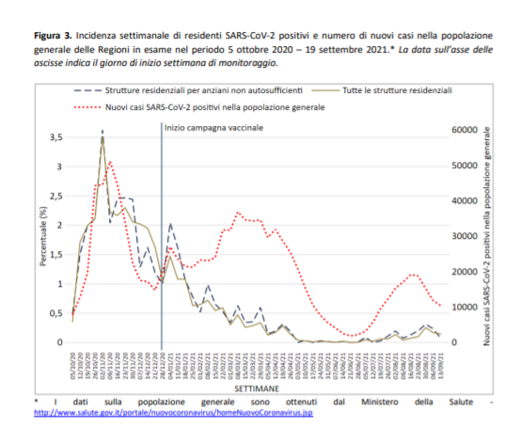
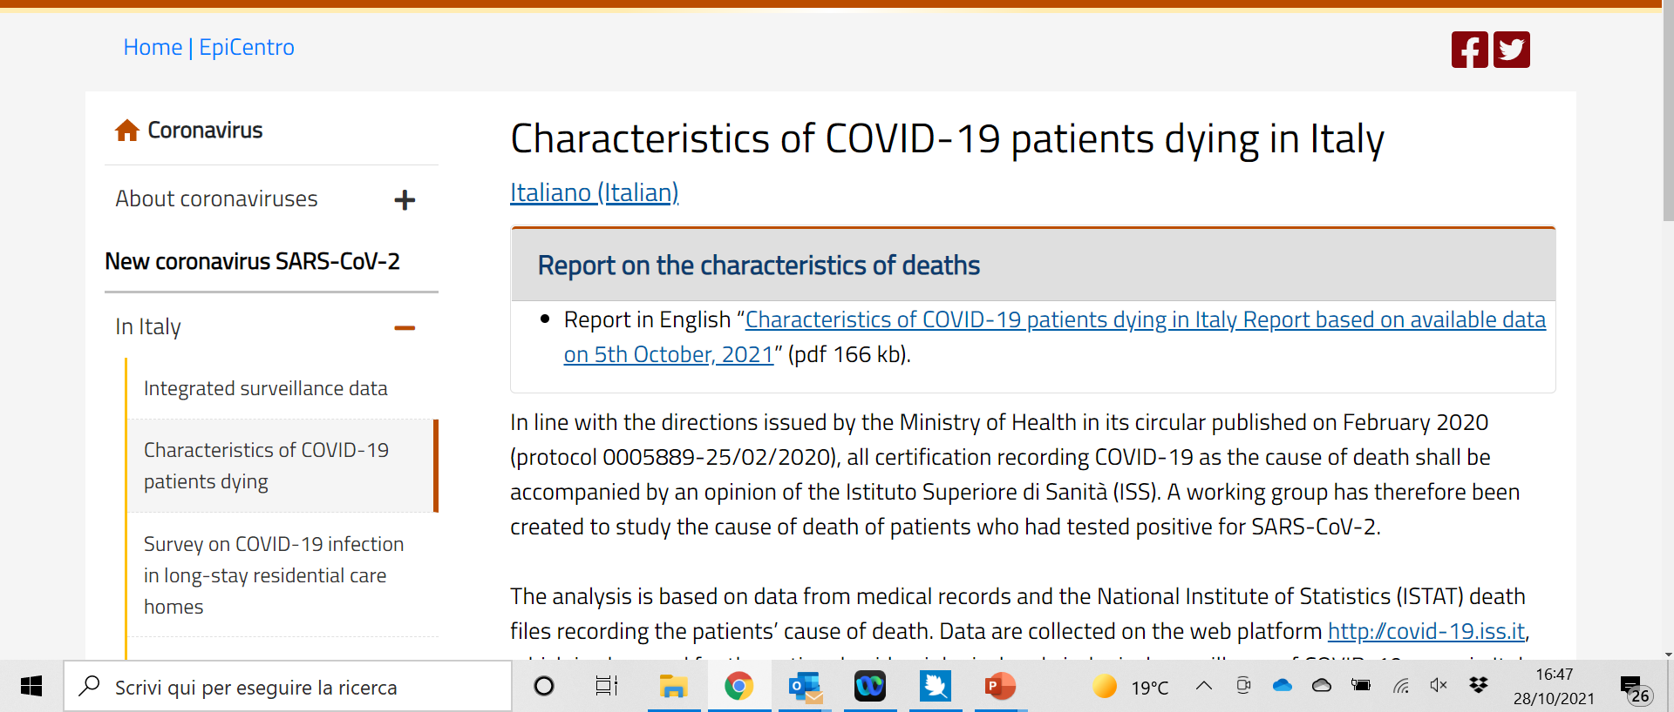
Focussed monitoring
Response pillars – data for action
Retrospective in-depth analysis of a sample of clinical charts of patients who died with a SARS-CoV-2 infection in Italy
Frequency and impact of SARS-CoV-2 infections in long-term care facilities
https://www.epicentro.iss.it/coronavirus/

Slide 26
E-Learning trend 2018-2021
EDUISS (ISS E-learning platform) new account 2018-2021
Over 700,000 registrations
for 18 courses on the EDUISS platform
13 with CMEs credits for Healthcare Professionals
2 for operators and social workers
1 for school
2 international courses
5 courses in advanced design phase
2021
Notes:
Although the potential and educational validity of e-learning was already clearly known in 2018 and 2019, the slide shows in an incontrovertible way the expansion that e-learning has forcibly achieved in 2020 and continue to reach, having multipled exponentially the number of healthcare participants, first of all among physicians.

Slide 27
Physicians daily enrollment and completion
Notes:
Physicians daily enrollment and completion: Great attention to the methodology, focus on Problem-Based Learning to stimulate the participation of adult learners, in continuing education, to study about a new disease, quite unknown. Stimulating research of reliable sources as well as providing evidence that is not yet stable can make great difference. In this context, the work in progress with the WHO Academy aimed at complementing PBL with competency-based methodology may also provide very interesting further developments.

Slide 28
Emerging topics for medical nad health care professionals education
Preparedness
One Health
Integrated Surveillance
Infection Prevention & Control / AMR
Public Health Intelligence
Multidisciplinary, Multiprofessional
Team working
Pandemic Response
Risk Communication

Slide 30

Public Health Workforce:
a Laboratorium for improving training in prevention, preparedness, and response to health crises
Repository
Prototype course
Collating and classifying
training resources and materials, based on existing or newly-developed International Competency Frameworks for the Public Health Workforce
Competence-oriented active learning-PBL for the public health workforce
Design of an e-learning pilot course on Epidemic Intelligence
Notes:
Public Health Workforce: a Laboratorium for improving training in prevention, preparedness, and response to health crises

Slide 31
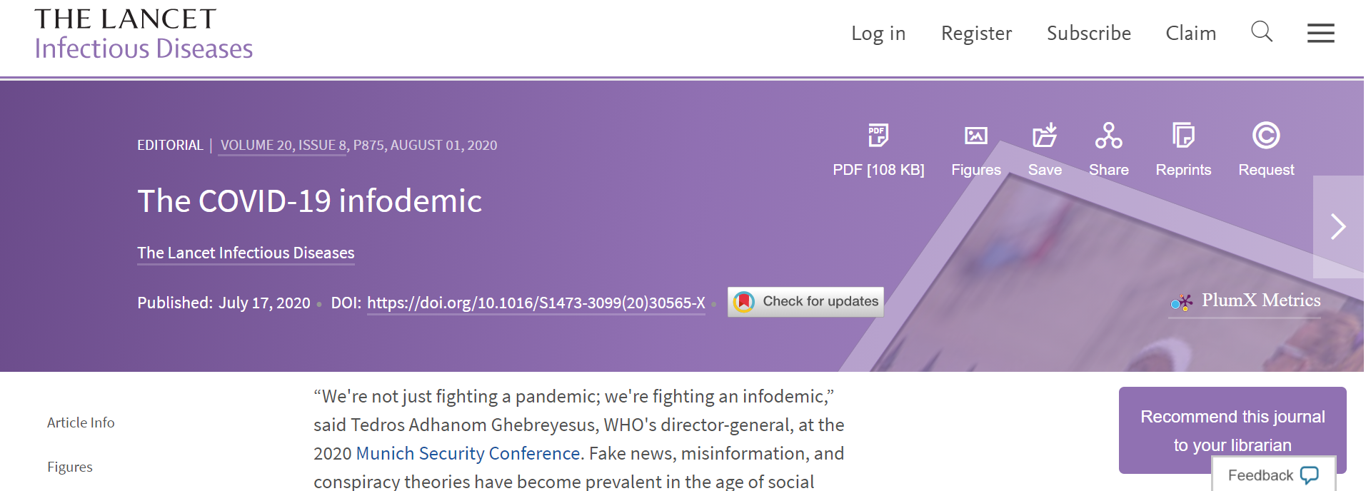
Information and infodemic
The central role of communication
https://www.thelancet.com/journals/laninf/article/PIIS1473-3099(20)30565-X/fulltext?dgcid=raven_jbs_etoc_email

Slide 32
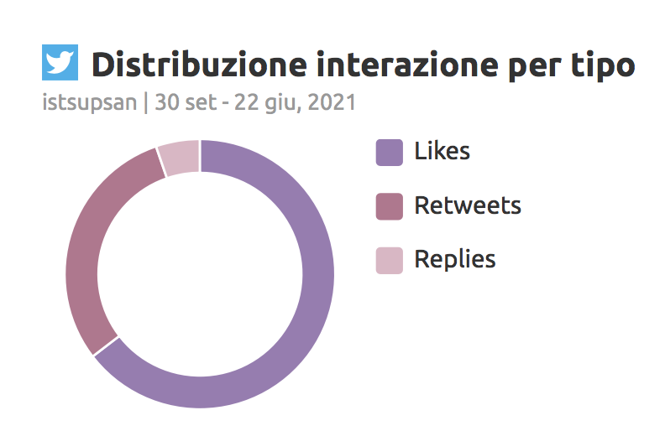



‘Traditional’ press office activities
Social media - Trend Follower e interactions
Since the beginning of the pandemic
More than 400 press releases
More than 200K citations on the press
More than 500 interviews (given by the President or Iss experts)
Press conferences (weekly)
80K follower on Twitter
25K on Facebook
8K on Instagram
80K follower on Twitter
25K on Facebook
8K on Instagram
Iss citations on the press

Slide 33



Examples

Slide 34
Building «TRUST»
JAMA series 2019

Slide 35



Slide 36
Thank you.
Thanks to our colleagues
who during this pandemic do not hesitate
to serve tiressly and, sometimes to sacrifice themselves,
to protect and assist their patients and communities
obeying to our Hyppocrate Oath

